Slide 1

Data Viewer Integration
Messaging Protocol
SR Research Ltd.
Toronto - Ottawa, Canada

Slide 2
Agenda
Brief overview of Data Viewer
  For more info check out Data Viewer Video Tutorials at www.sr-support.com
Brief overview of EyeLink API, which allows experimental programming environments (e.g., Psychtoolbox for Matlab, Psychopy, E-Prime, NBS Presentation, Python, C/C++) to communicate with EyeLink systems
Discussion of messaging protocol options and how to use them

Slide 3
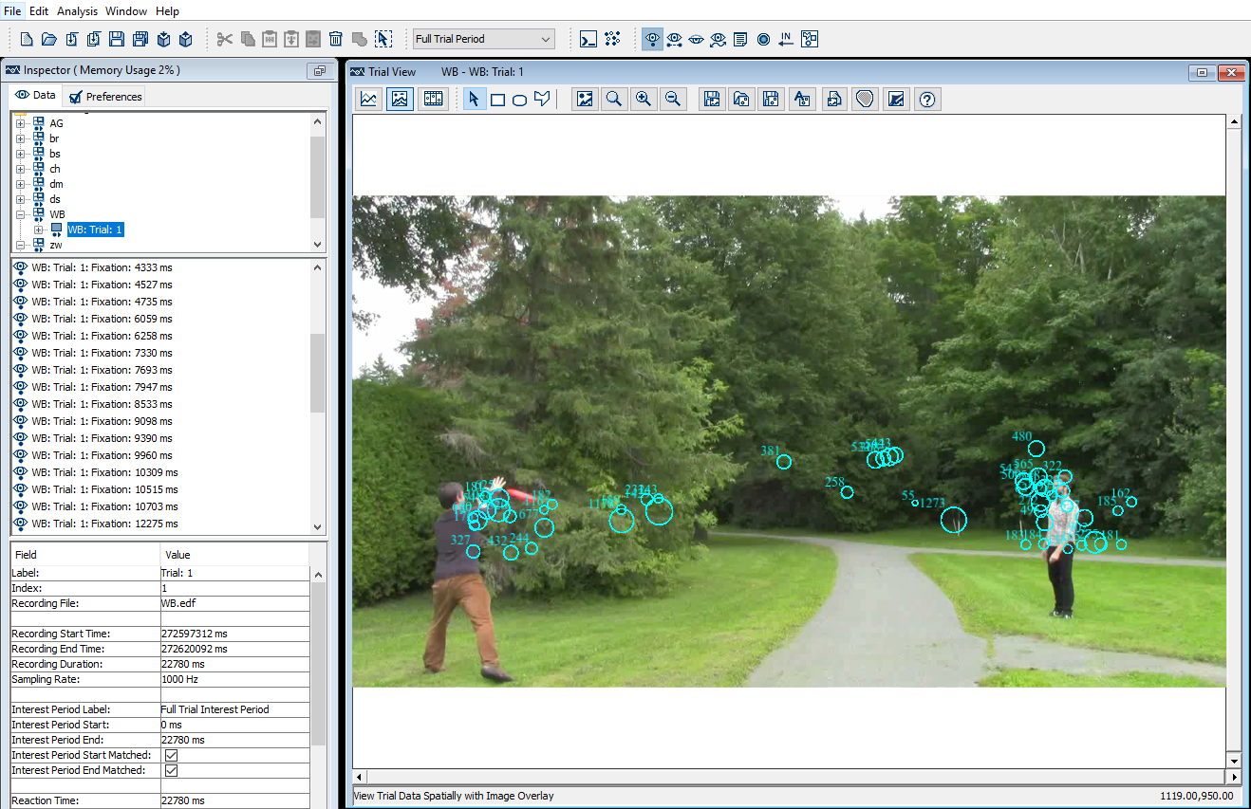
Data Viewer
Data Viewer is used for viewing, filtering, and processing gaze data recorded with EyeLink eye trackers.
Runs on Windows, macOS, and Linux

Slide 4
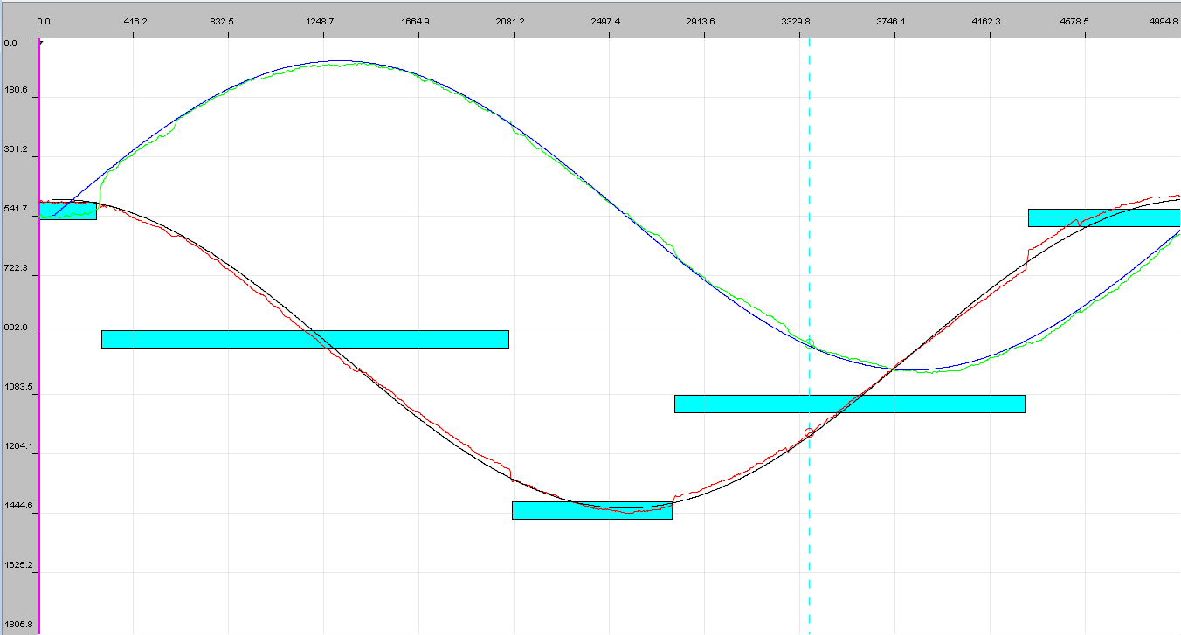
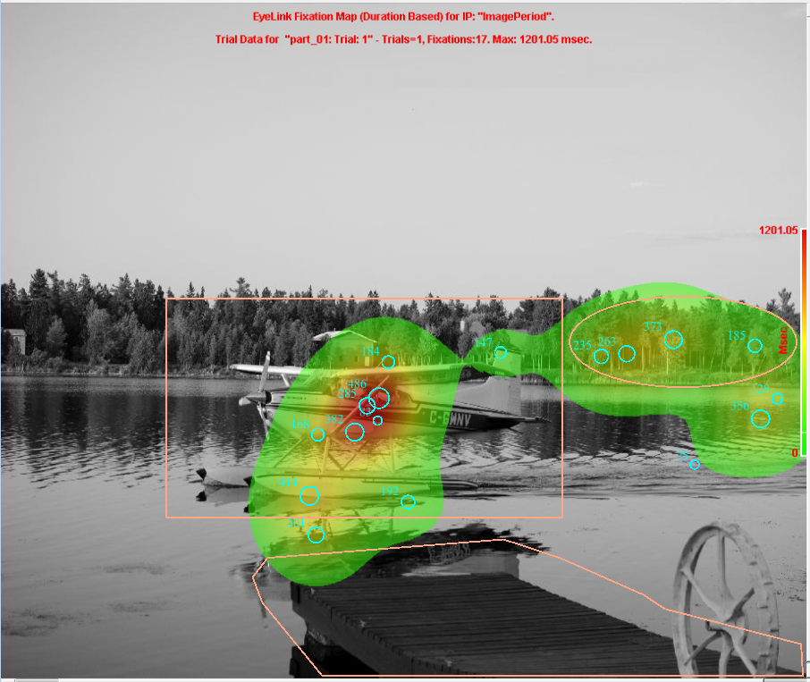
Data Viewer
Various visualization options, including spatial overlay, temporal graph, playback, and fixation/heat maps

Slide 5
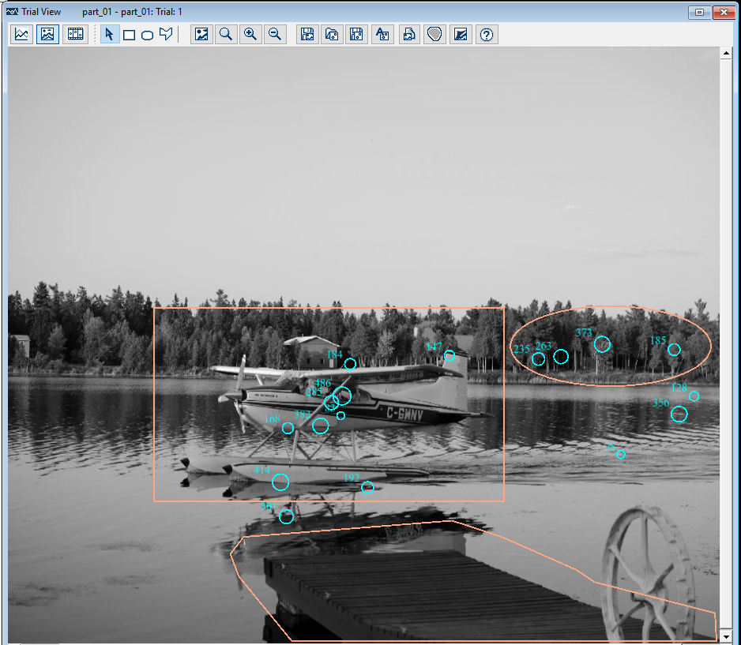
Data Viewer
Allows matching of gaze data to interest areas

Slide 6
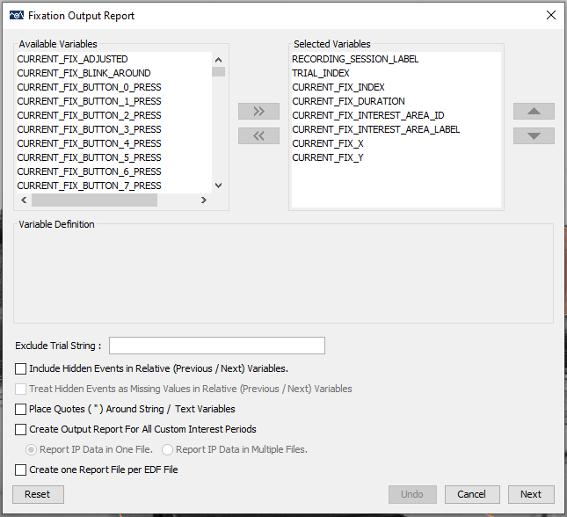
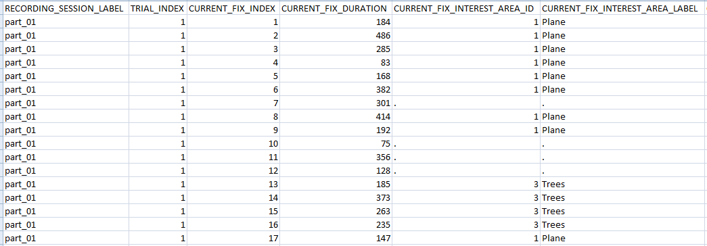
Data Viewer
Output reports to summarize the data -- these can then be input to statistical packages

Slide 7
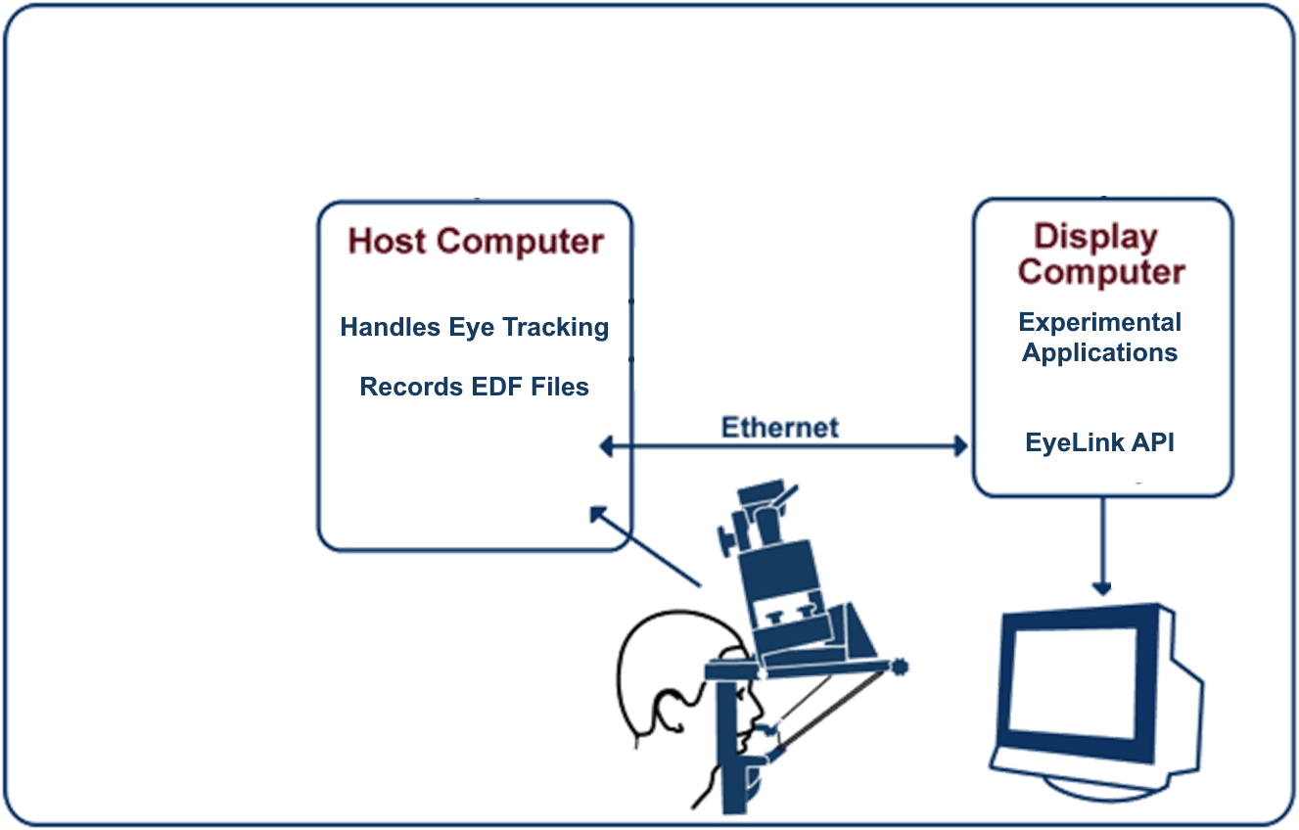
Overview of EyeLink API
Two computers in EyeLink Setup – Display PC applications use EyeLink API to communicate with Host PC
API:
Allows eye tracker functions (e.g., calibration, drift check)
Starts/stop eye tracker recording
Allows commands to be sent to update tracker settings
Allows messaging to mark experimental events
Allows messaging to communicate with Data Viewer

Slide 8
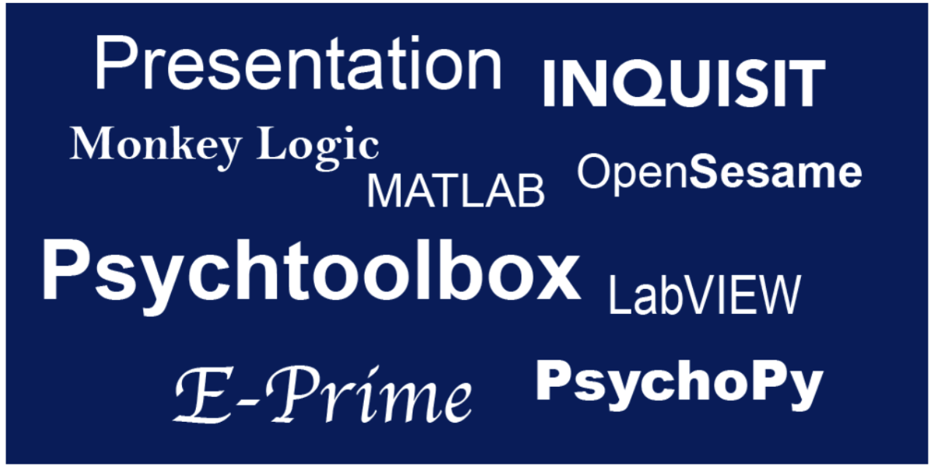

Overview of EyeLink API

Slide 9
Messaging Protocol
When you send messages, it’s often just to mark timing of experimental events, but you can send other special Data Viewer messages
These allow you to create EDF files that are compatible with Data Viewer
  Display Size Message
    DISPLAY_COORDS 0 0 1919 1079
  Trial Onset Messages
    TRIALID 1 (TRIALID2, etc.)
  Trial Event Messages
    DISPLAY_IMAGE
    DISPLAY_QUESTION
    BUTTON_PRESS
    DISPLAY_FEEDBACK
  Image Load Messages
    !V IMGLOAD CENTER ../images/plane.png 960 540
  Video Frame Display Messages
    !V VFRAME 27 0 0 ../videos/frisbee.mp4
  Simple Drawing Messages
    !V DRAWBOX 128 128 128 300 400 600 700
  Target Position Messages (for moving targets)
    !V TARGET_POS Targ1 (512, 384) 1 0
    !V TARGET_POS Targ1 (512, 364) 1 0
  Trial Variable Messages
    !V TRIAL_VAR trial_condition condition_1
    !V TRIAL_VAR reaction_time 2364
  Interest Area Messages
    !V IAREA RECTANGLE 1 242 336 692 585 plane
  Trial Offset Messages
    TRIAL_RESULT 0

Slide 10
Messaging Protocol
  Display Size Message
    DISPLAY_COORDS 0 0 1919 1079
  This should be sent at the beginning of the experiment, before any trials are run
  It provides Data Viewer with information about the screen resolution of the Display PC monitor, and makes it so that Data Viewer formats its Trial View Window appropriately. Should be 0 0 Width-1 Height -1

Slide 11
Messaging Protocol
  Trial Onset Messages
    TRIALID 1 (TRIALID2, etc.)
  This should be sent at the beginning of each trial
  It marks the onset of the trial and allows Data Viewer to break the single EDF file into its multiple trials
  A complementary Trial Offset Message (TRIAL_RESULT) should be sent at the end of each trial

Slide 12
Messaging Protocol
  Trial Event Messages
    DISPLAY_IMAGE
    DISPLAY_QUESTION
    BUTTON_PRESS
    DISPLAY_FEEDBACK
  These are used to mark experimental events and can be used to set Interest Periods in Data Viewer
  They can be whatever you want, but you should be consistent across trials – if the message changes across trials then when you set an interest period it will only apply to the trials that have that messaging

Slide 13
Messaging Protocol
  Image Load Messages
    !V IMGLOAD CENTER ../images/plane.png 960 540
  These tell Data Viewer to load that image at the time of the message so that the stimulus can be seen as background over which gaze data is overlaid
  After IMGLOAD, should specify position type, path to image (relative to EDF location), position, and optional size
  There are three types of IMGLOAD messages
    CENTER – the image is positioned such that its center is positioned at specified X,Y coordinate
    TOP_LEFT – the image is positioned such that its top-left corner is positioned at the specified X,Y coordinate
    FILL – the image is fit to the screen (it is stretched to fill screen if its size is less than resolution)
    CENTER and TOP_LEFT can include optional width and height arguments:
    !V IMGLOAD CENTER ../images/plane.png 960 540 600 400

Slide 14
Messaging Protocol
  Video Frame Display Messages
    !V VFRAME 27 0 0 ../videos/frisbee.mp4
  These tell Data Viewer to play a particular frame of the video at the time of the message
  After the VFRAME, should give frame number, top-left X,Y coordinate of video, and path to video (relative to EDF location)

Slide 15
Messaging Protocol
  Simple Drawing Messages
    !V DRAWBOX 128 128 128 300 400 600 700
  These tell Data Viewer to draw a shape of certain color at a certain location
  Exact parameters depend on shape drawn (see DV manual for more info). Options include:
    CLEAR – clears screen
    DRAWLINE – draws a line
    DRAWBOX – draws an unfilled box
    FILLBOX – draws a filled box
    FIXPOINT – draws a circle with a dot inside

Slide 16
Messaging Protocol
  Draw List Message
  !V DRAW_LIST draw_files\myDrawFile.vcl
  These tell Data Viewer to load image, video, and simple drawing commands from a text file
  The text file should have the drawing commands without the !V at the beginning. Each line should start with time of drawing relative to the time of the DRAW_LIST message (i.e., the DRAW_LIST message time is the 0 point for the drawing commands; times should be negative – they’re offsets)
  0 CLEAR 153 153 153
  0 IMGLOAD CENTER ../../runtime/images/-4562545002357104754.png 512 384 1024 768
  -5000 CLEAR 153 153 153
  -5000 IMGLOAD CENTER ../../runtime/images/1853639206197164775.png 512 384
  -6833 CLEAR 153 153 153
  -6833 IMGLOAD CENTER ../../runtime/images/8781210645090787058.png 512 384
  -8833 CLEAR 153 153 153
  Can be useful if there are a lot of drawing messages

Slide 17
Messaging Protocol
  Target Position Messages (for moving targets)
    !V TARGET_POS Targ1 (512, 384) 1 0
    !V TARGET_POS Targ1 (512, 364) 1 0
  These provide the position of a target over time to Data Viewer
  Target position can be visualized in Temporal Graph View and can be output alongside gaze data in Sample Reports (as well as target velocity and acceleration)
  Specify the name of the target, the X,Y coordinate (at time of message, the visibility of the target (for cases where target disappears and reappears), and the step/interpolation status

Slide 18
Messaging Protocol
  Interest Area Messages
    !V IAREA RECTANGLE 1 242 336 692 585 Plane
    !V IAREA FREEHAND 2 419,765 351,682 340,653 357,631 625,610 689,631 784,673 808,689 963,729 965,765 Dock
    !V IAREA ELLIPSE 3 700 334 958 437 Trees
  These create Interest Areas in Data Viewer, which are used in analysis to determine how gaze data maps to different parts of screen
  Interest Areas can also be dynamic – if so, you can specify start and end time of each instance of interest area (see manual for more information on formatting)
  Can be rectangle, ellipse, and freehand
    For rectangle and ellipse, specify ID, left, top, right, bottom, and label
    For freehand, specify ID, list of X,Y points, and label
  Note, interest areas can also be created in Data Viewer

Slide 19
Messaging Protocol
  Interest Area File Messages
    !V IAREA FILE segments\example.ias
  These point to an Interest Area Text File. The text file in turn contains the interest area messages without the !V at the beginning
  For static interest areas, the time of the onset of the interest area relative to the time of the IAREA FILE message should be specified
  -200 RECTANGLE 1 242 336 692 585 Monkey
  -200 ELLIPSE 2 700 334 958 437 Giraffe
  For dynamic interest areas, the time of the onset and offset of each instance should be specified
  -200 -400 RECTANGLE 1 242 336 692 585 Monkey
  -200 -400 ELLIPSE 2 700 334 958 437 Giraffe
  -401 -600 RECTANGLE 1 348 392 526 846 Monkey
  -401 -600 ELLIPSE 2 319 412 954 576 Giraffe

Slide 20
Messaging Protocol
  Trial Variable Messages
    !V TRIAL_VAR trial_condition condition_1
    !V TRIAL_VAR reaction_time 2364
  These create Trial Variables in Data Viewer. Data can be grouped by the values of the variables and the variables can be included in any of the output reports that are created by Data Viewer
  Typically these include independent/condition variables and dependent behavioral variables
  Typically sent at end of trial
  Should specify name of variable then value of variable

Slide 21
Messaging Protocol
  Trial Offset Messages
    TRIAL_RESULT 0
  This marks the end of the trial for Data Viewer
  Is complement to the TRIALID message that marks the trial onset

Slide 22
Messaging Protocol
  Message Offset values
  Sometimes it’s not possible to send a message at the time of an event. In that case, you can send the message before or after the event, and precede the message with an offset value. Data Viewer will take the offset value into account by subtracting it from the time stamp of the message in the EDF. This effectively repositions the message forward or backward in time.
  Can be used for any of the messages discussed
  650 DISPLAY_IMAGE
  This will move the message backwards in time 650 msec
  -650 DISPLAY_IMAGE
  This will move the message forwards in time 650 msec

Slide 23
Thank you!

